Slide 1
Beans disease

Slide 2
Introduction
The images were captured in bean fields by the AI lab in collaboration with the National Crops Resources Research Institute (NaCRRI), Uganda's national body in charge of agricultural research.
The dataset was already split into train, test, and validation sets. However, we merged the train, test, and validation images manually, and used the XnViewMP program to rename the files

Slide 3
About data set
.There are three classes in the dataset: Angular Leaf Spot, Bean rust, and Healthy
.This directory contains two folders namely: angular_leaf_spot, and healthy. Angular_leaf_spot contains 330 images ,bean rust contains 330 images and healthy contains 660 images .

Slide 4
Image conversion
The collected images were converted into binary form as 0's and 1's of each image
This is helpful for the user to know whether the beans have disease or not

Slide 5
supervised learning:
Supervised learning is the types of machine learning in which machines are trained using well "labelled" training data, and on basis of that data, machines predict the output. The labelled data means some input data is already tagged with the correct output.
In supervised learning, the training data provided to the machines work as the supervisor that teaches the machines to predict the output correctly. It applies the same concept as a student learns in the supervision of the teacher.

Slide 6
Supervised learning classification methods :
Classification algorithms are used when the output variable is categorical, which means there are two classes such as Yes-No, Male-Female, True-false,0 or 1 etc.
Random Forest
Decision Trees
Logistic Regression
Support vector Machines
Knn algorithm

Slide 7
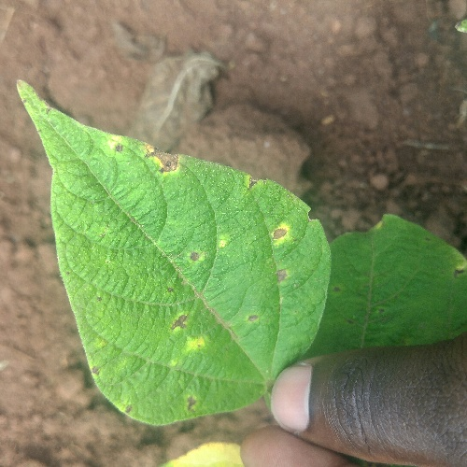
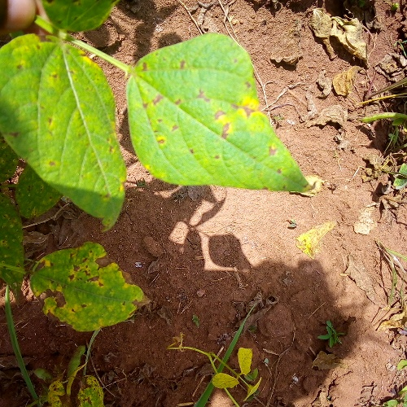
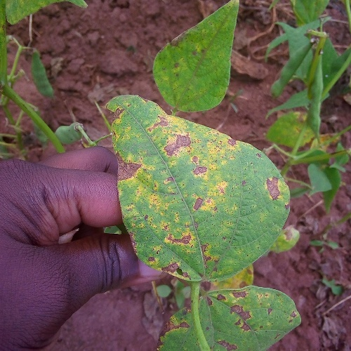
Data set
Angular leaf spot :

Slide 8
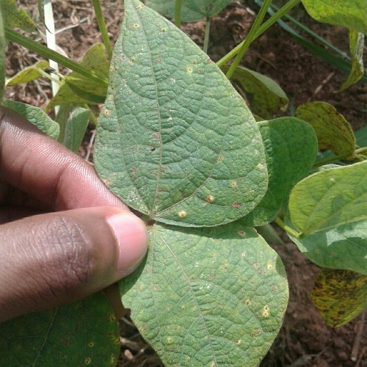
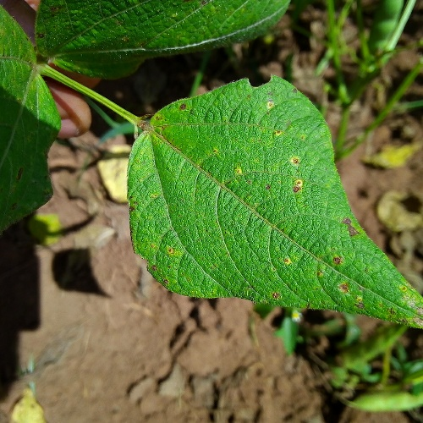
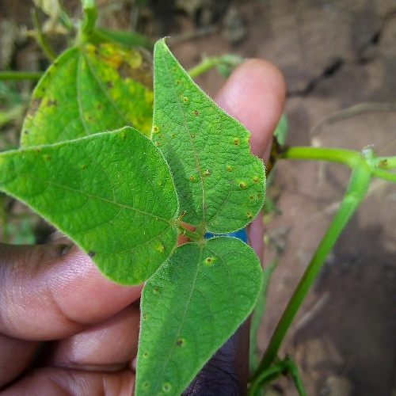
Bean rust:

Slide 9
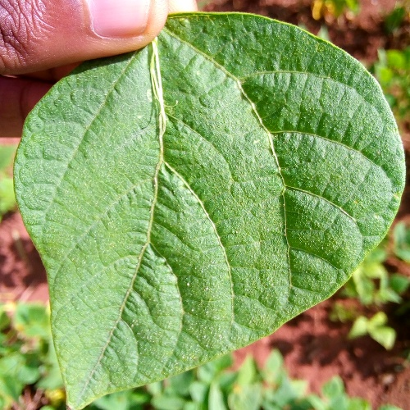
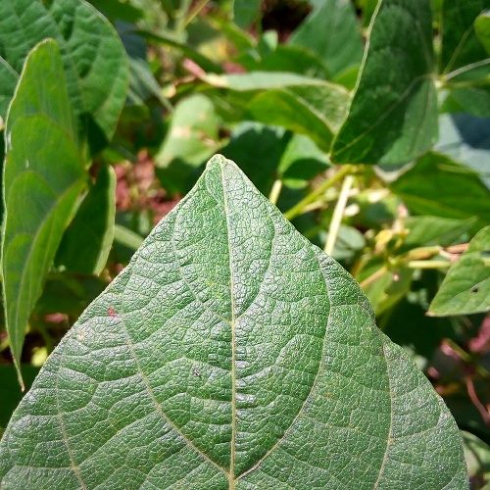
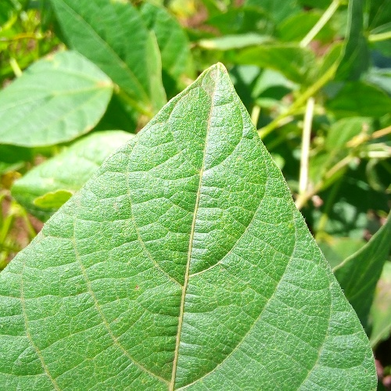
Healthy:

Slide 10
Code:
from tensorflow.keras.preprocessing.image import img_to_array
from tensorflow.keras.preprocessing.image import load_img
from sklearn.preprocessing import LabelBinarizer
!pip install imutils
from imutils import paths
from sklearn.utils import shuffle
import pandas as pd
import numpy as np
import random, os

Slide 11
x = [] y = [] width,height=224,224 df = list(paths.list_images('/content/drive/MyDrive/Bean_Dataset')) for imagePath in df: label = imagePath.split(os.path.sep)[-2] image = load_img(imagePath, target_size=(width, height)) image = img_to_array(image) x.append(image) y.append(label)

Slide 12
x = np.array(x, dtype="float32") y = np.array(y) lb = LabelBinarizer() y = lb.fit_transform(y) data, labels = shuffle(x, y) print(data.shape) print(labels.shape)

Slide 13
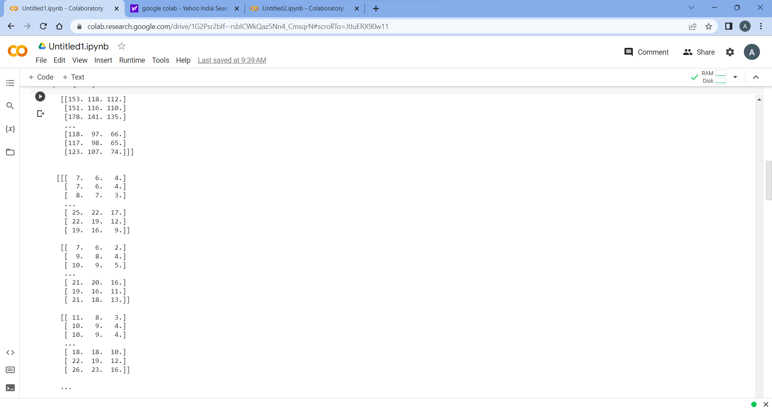
Data:

Slide 14
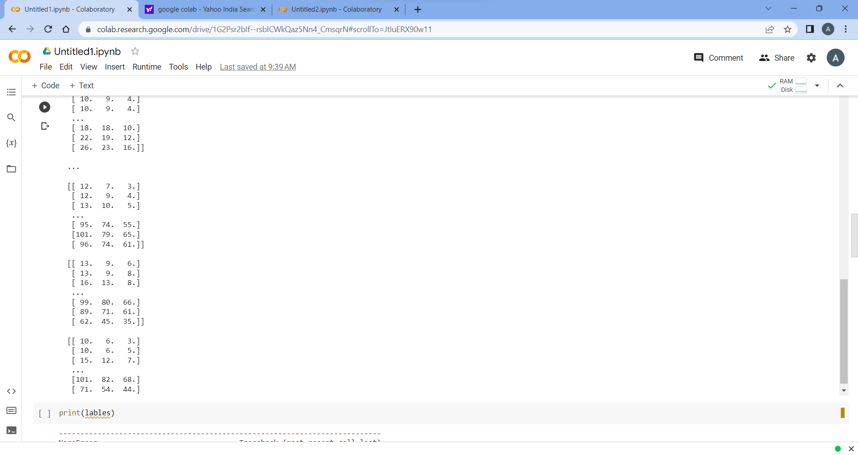

Slide 15
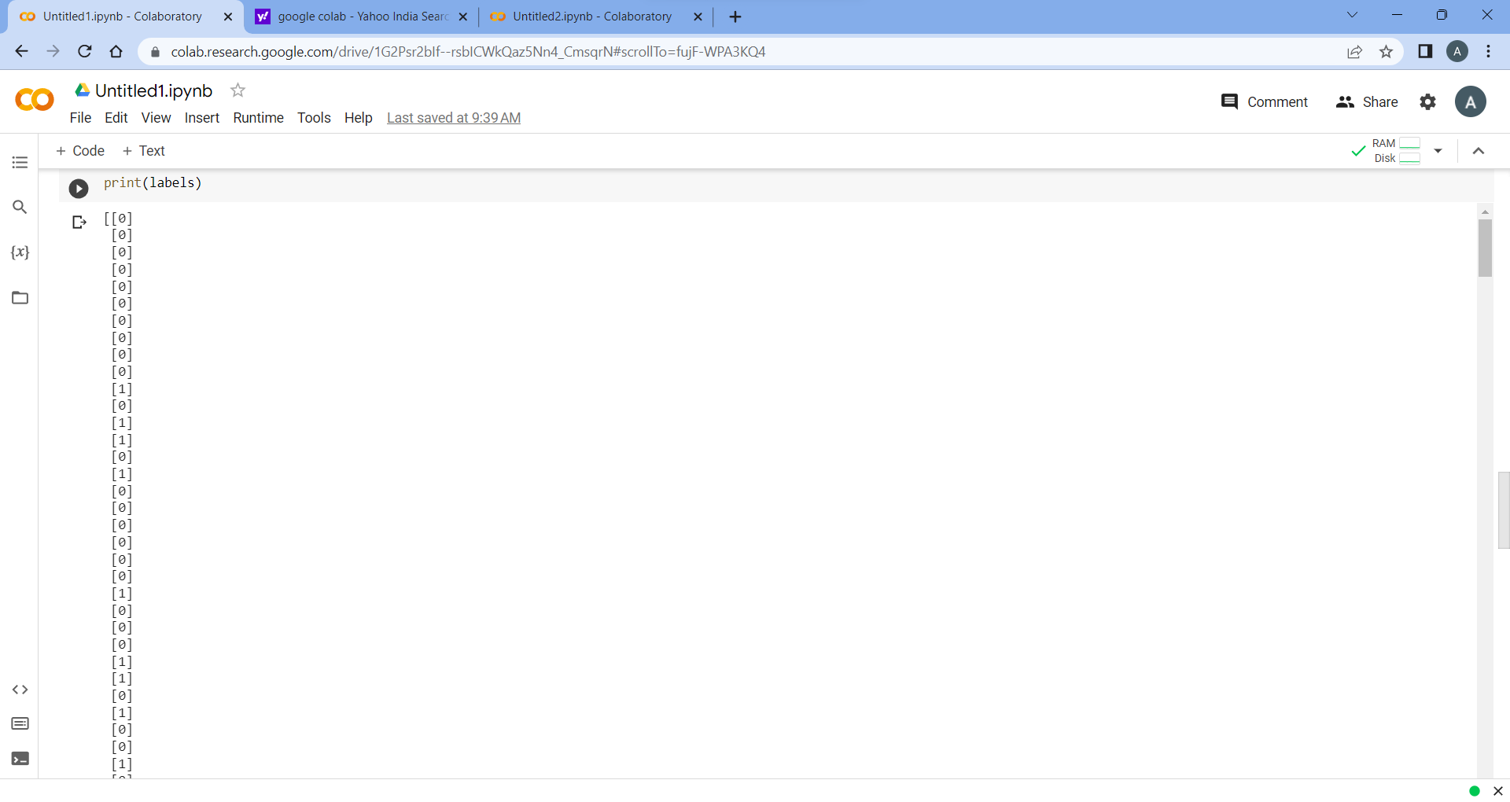
Labels:

Slide 16
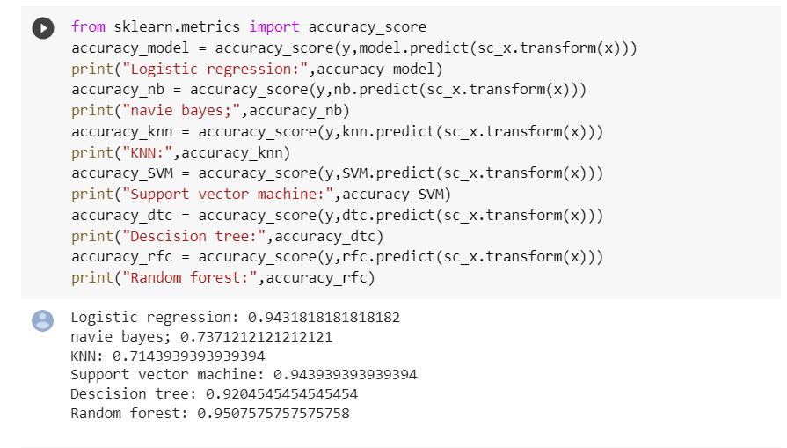
Accuracy Results:

Slide 17
Logistic regression:
Confusion matrix:
[117 41]
[34 138]

Slide 18
Naïve bayes confusion matrix:
[115 43]
[ 54 118]

Slide 19
Support vector machine:
[134 24]
[ 28 144]

Slide 20
Decision tree classifier confusion matrix:
[107 51]
[ 54 118]

Slide 21
Random forest classifier confusion matrix:
[138 20]
[ 45 127]

Slide 22
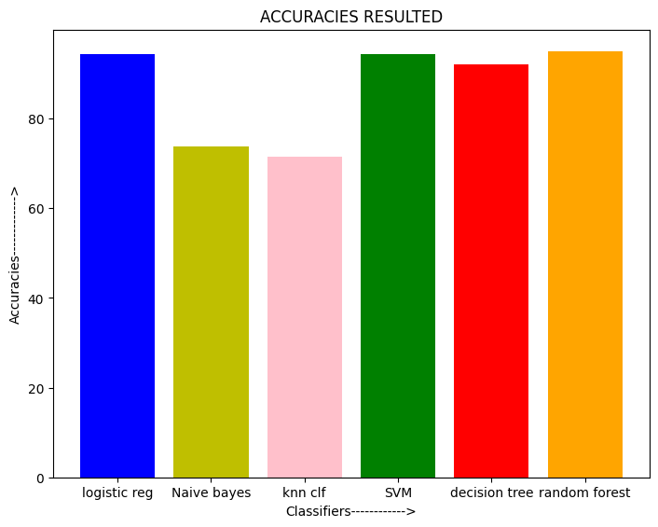
Accuracy:

Slide 23
Conclusion:
The accuracy of the prediction model depends on many factors, including the quality and quantity of the data, the complexity of the underlying disease, and the algorithmic approach used. It is important to note that AI/ML models are not perfect and can still make errors or miss important information, so they should be used as a supplement to, not a replacement for, human medical expertise.If you have specific medical concerns, it is always best to consult with a trained healthcare professional for diagnosis and treatment.

Slide 24
Thank you

